Slide 1
FAA Safety Team Webinar NWS Aviation Products
Kevin Kacan – NWS Detroit Meteorologist

Slide 2
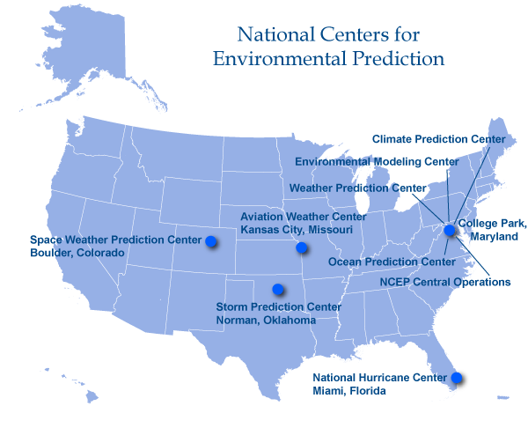
National Weather Service – National Divisions
NWS is one agency within the National Oceanic and Atmospheric Administration (NOAA), which is part of the US Department of Commerce
Data and products are used by other government agencies, the private sector, the public, and globally
Contains nine national centers
Includes the Aviation Weather Center and Storm Prediction Center

Slide 3
NWS Aviation Divisions
Aviation Services Branch – Silver Spring, MD
Oversees the entire NWS aviation program
Main liaison between NWS, FAA, and GA (AOPA)
Aviation Weather Center (AWC) – Kansas City, MO
Provides forecasts across the continental US and Caribbean
Area forecasts, AIRMETS, SIGMETS, turbulence, icing, and winds aloft
Operates the ADDS Website
Center Weather Service Units (CWSU) – Cleveland Air Route Traffic Control Center
Briefs air traffic controllers and respective TRACON on regional weather conditions
Issues Meteorological Impact Statements and Center Weather Advisories
Weather Forecast Offices (WFO) – Detroit

Slide 4
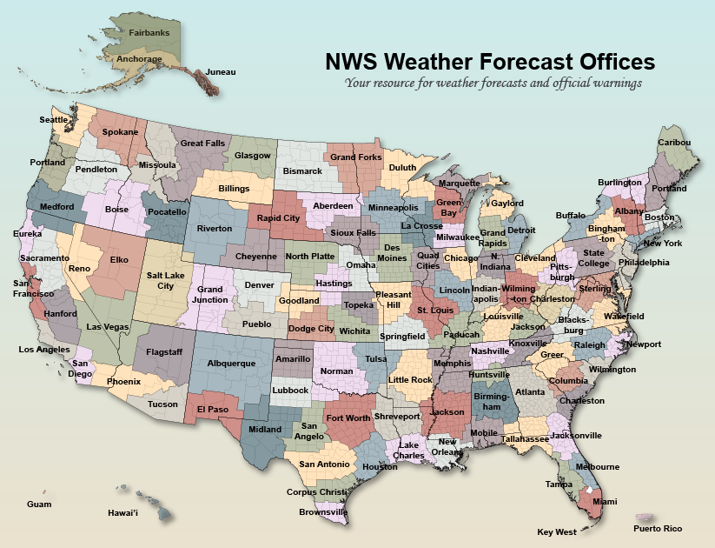
Weather Forecast Office –Detroit
One of 122 Weather Forecast Offices (WFOs) across the US
Staffed 24/7, year-round
Responsible for 17 counties in Southeast Michigan
Sole responsibility for issuing watches, warnings, and advisories
Tornado, Severe Thunderstorm, Winter Storm, Flash Flood, River Flood, Gale, etc.

Slide 5
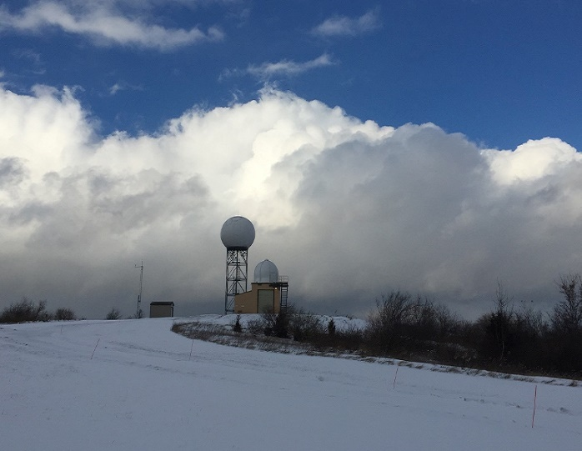
Weather Forecast Office – Detroit
Issues TAFs for 6 Airports
KDTW, KDET, KYIP, KPTK, KFNT, KMBS
TAFs issued on the synoptic hours: 00Z, 06Z, 12Z, 18Z
Amendments issued when forecasts change
KDTW is regularly amended halfway between the synoptic hours
KDTW TAF prior to June 10th, 2020 Wind Event
KDTW 101952Z 1020/1124 20016G28KT P6SM VCTS BKN040CB OVC060
TEMPO 1021/1023 22020G40KT 2SM +TSRA BKN035CB OVC050
FM102300 22010KT P6SM SCT035 OVC060
FM110100 24018G28KT P6SM SCT035 BKN060
FM110500 27015G25KT P6SM BKN028
FM111100 25014G22KT P6SM SCT030
FM111500 27016G25KT P6SM SKC=
Aviation Forecast Discussions

Slide 6
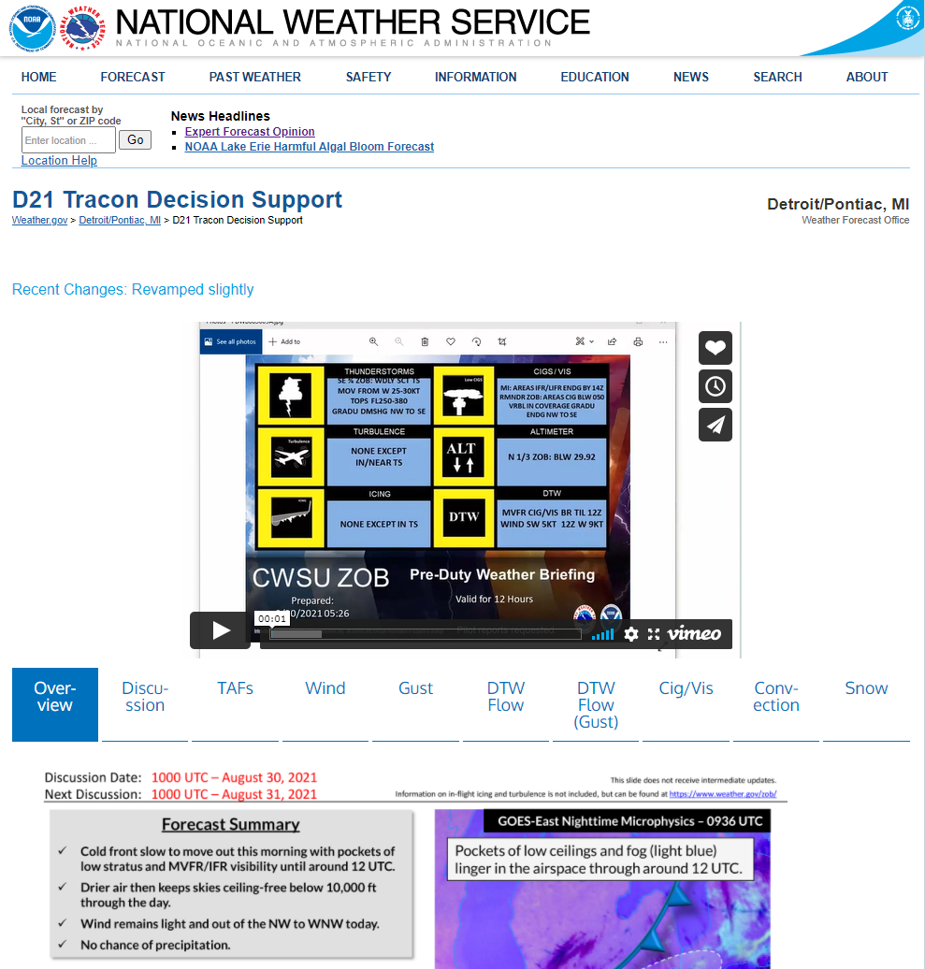
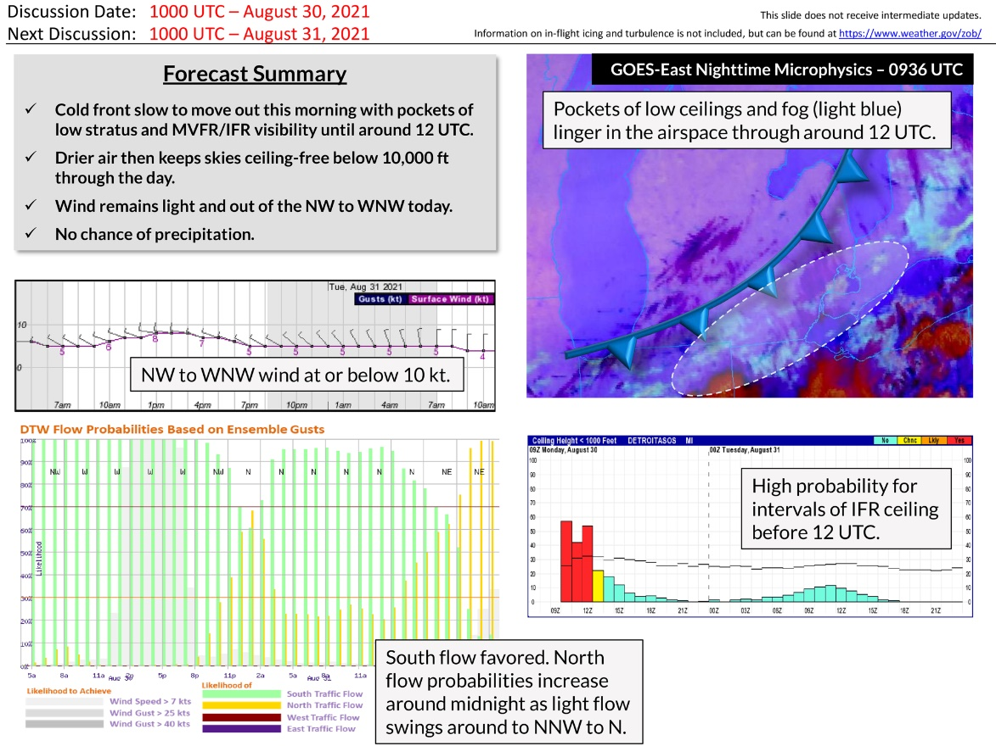
D21 Support Page
Compiled resources specific to both D21 TRACON and NWS Detroit’s 6 TAF sites
Includes the current aviation forecast discussion, TAFs, probabilistic forecasts, and other aviation resources
Cleveland CWSU’s Pre-Duty Briefing
Daily D21 Decision Support Graphic
https://www.weather.gov/dtx/d21dss

Slide 7
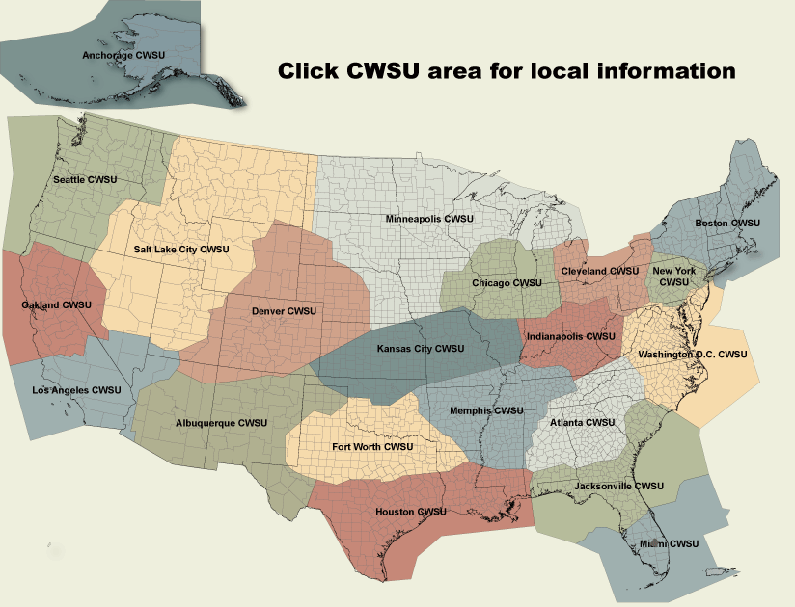
Cleveland CWSU
One of 21 Center Weather Service Units (CWSUs) co-located with Air Route Traffic Control Centers (ARTCC)
Focus on aviation weather for the Cleveland ARTCC, producing tailored forecasts and advisories for thunderstorms, turbulence, icing, and precipitation
Convey a variety of weather information to on-site air traffic controllers, vital in helping the FAA efficiently and safely route traffic
https://www.weather.gov/zob/
Notes:
The catalyst that placed weather personnel in each ARTCC was the 1977 crash of Southern Airways flight number 242, which flew into a thunderstorm and crashed en-route to Atlanta. Both engines flamed out due to hail ingestion. The ensuing investigation suggested that Air Traffic Controllers needed a better way to receive timely weather information, hence the CWSU program was born.

Slide 8
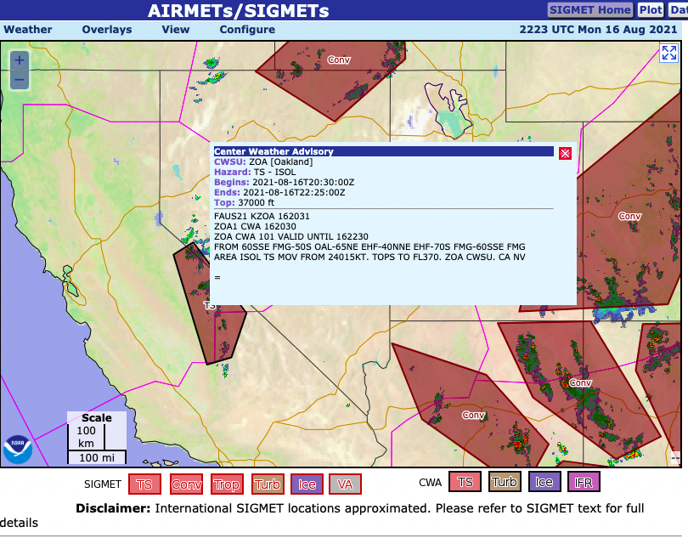
Products
Issue Meteorological Impact Statements and Central Weather Advisories
Similar to WFO Severe Warnings
Pre-Duty Weather Briefings videos created three times daily
Provide situational awareness for air traffic controllers starting shifts
Summarize weather current and forecast FL winds, TAF categories, turbulence, icing, thunderstorms
https://www.weather.gov/zob/predutyweatherbriefing

Slide 9
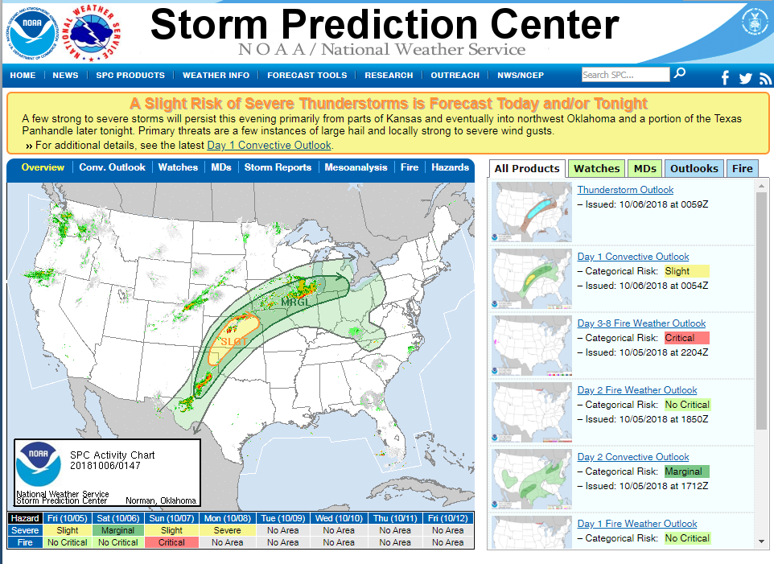
Storm Prediction Center
Located in Norman, OK
Issue national thunderstorm outlooks and mesoscale discussions (MDs)
WFOs coordinate with SPC for Severe Thunderstorm and Tornado Watches
SPC MDs/outlooks sometimes impact Convective SIGMETs
Most common severe thunderstorm risks for the Great Lakes are:
General Thunderstorms, Marginal, and Slight Risks
https://www.spc.noaa.gov

Slide 10
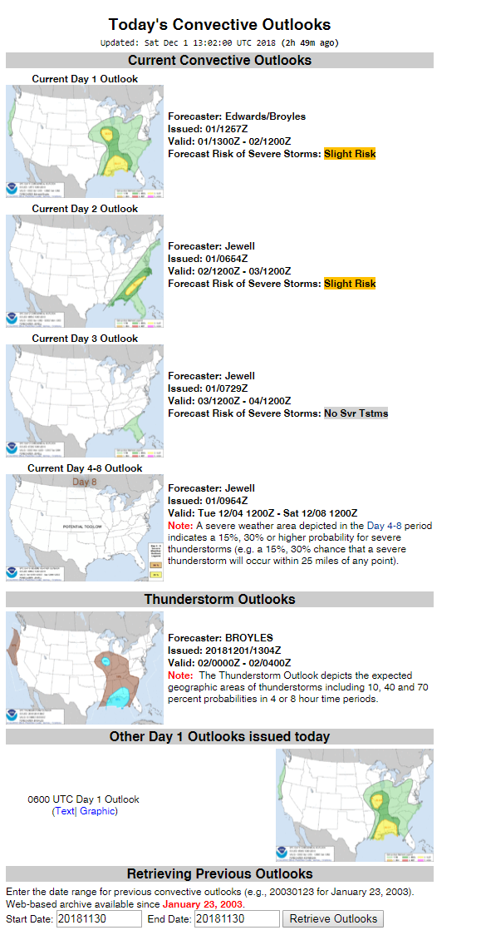
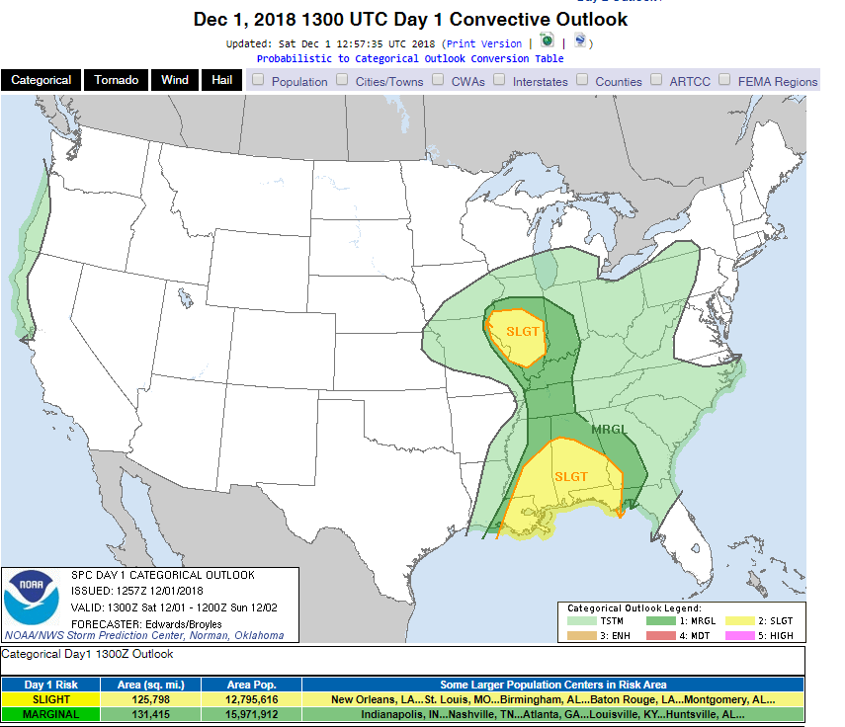
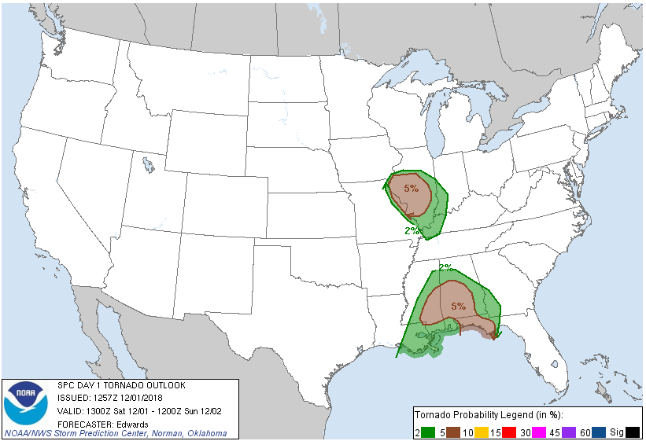
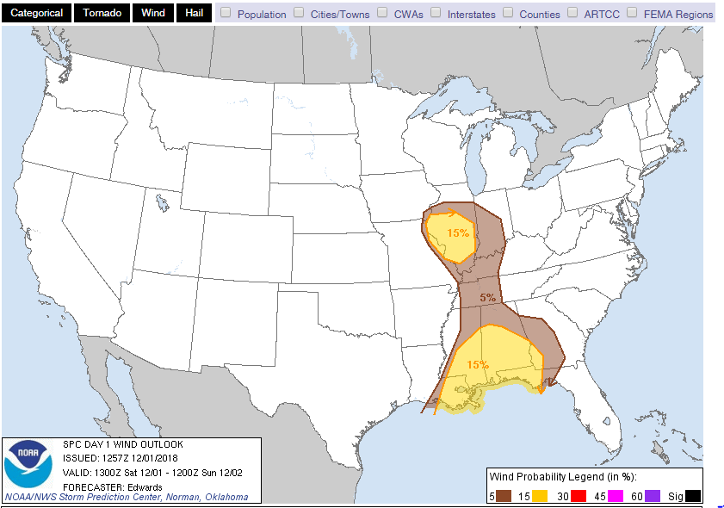
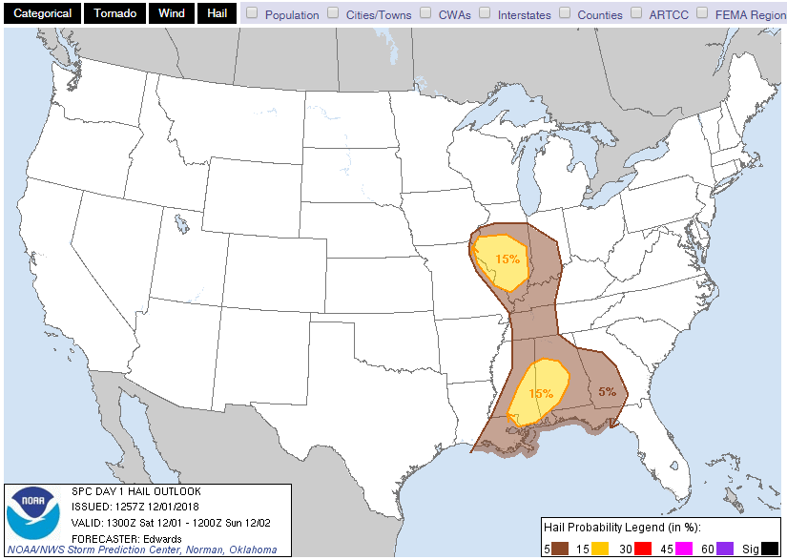
Thunderstorm Outlooks issued out to 8 days
Storm Prediction Center
Tornado Outlook
Can view individual severe hazards for the current day and tomorrow, along with a forecast discussion
Wind Outlook
Hail Outlook

Slide 11
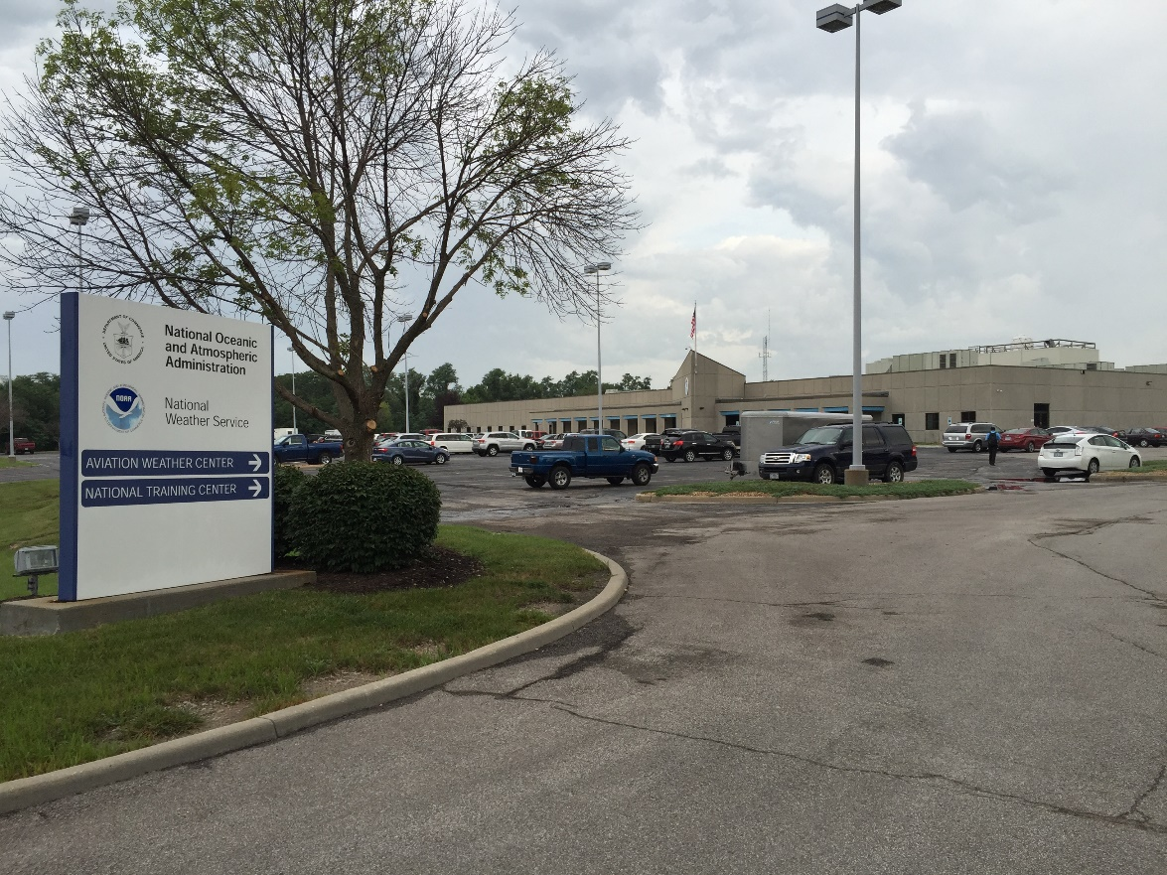
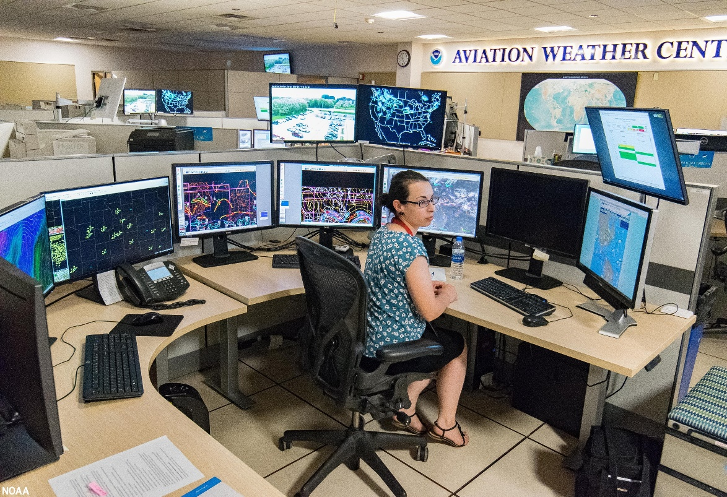
AWC Resources
Surface Observations (METARs)
TAFs
PIREPS
Advisories
SIGMETs & AIRMETs
ADDS
Turbulence
Icing
Winds Aloft
https://www.aviationweather.gov/

Slide 12
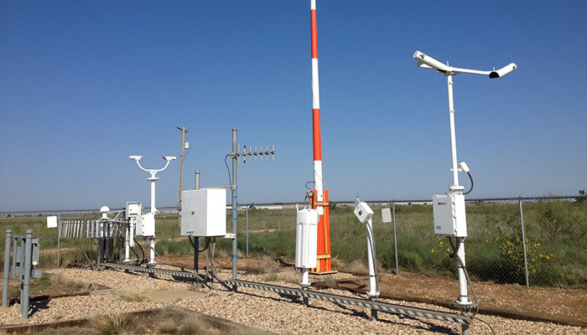
METARs
ASOS (Automated Surface Observing Systems)
Sky conditions
Surface visibility
Present weather type and intensity
Obstructions to vision like fog, haze, and dust
Sea-level pressure and altimeter
Air and dew point temperatures
Wind direction, speed and character (gusts, squalls)
Notes:
Precipitation accumulation
Selected significant remarks including variable cloud height, variable visibility, precipitation beginning/ending times, rapid pressure changes, pressure change tendency, wind shift, peak wind
AWOS, AWS, CoCoRaHS, COOP, CWOP, MesoWest, RAWS, WXFLOW

Slide 13
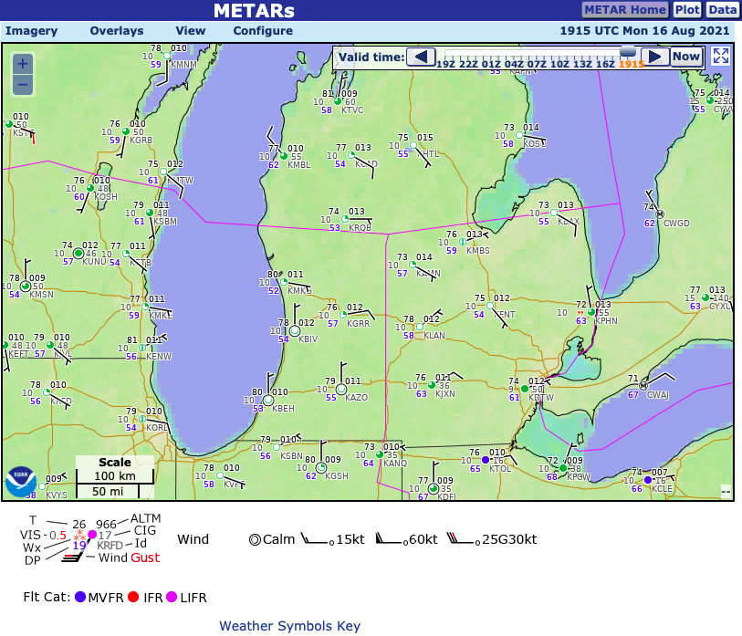
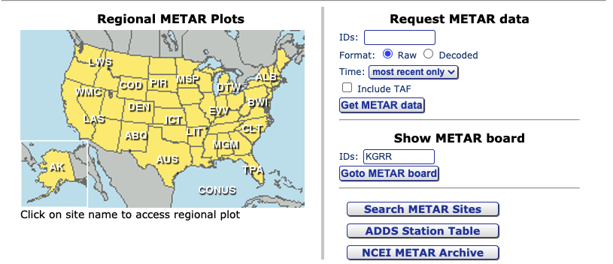
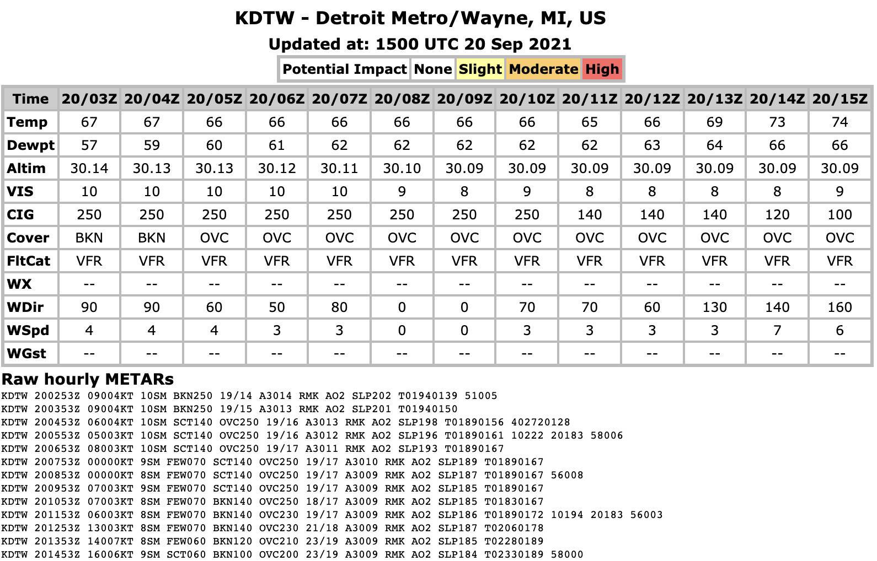
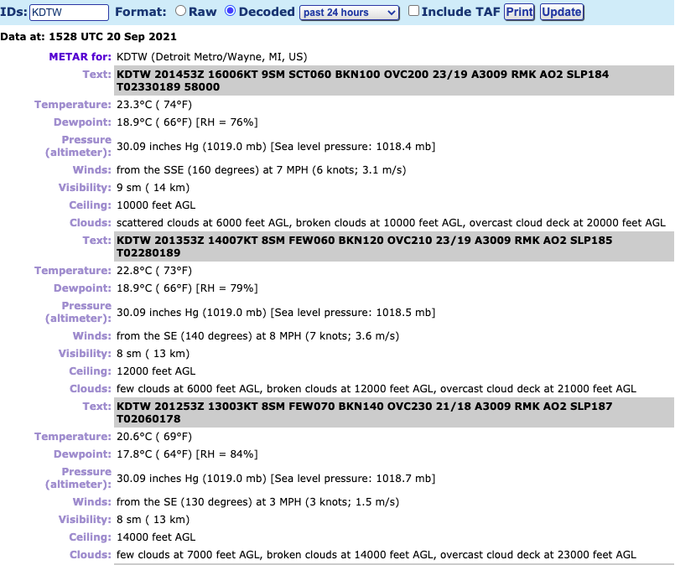
METARs
METeorological Aerodrome Reports (METARs)
Applies to ASOS and Automated Weather Observing Stations (AWOS)
AWC compiles all METAR data, searchable by airport ID code (ICAO)
METAR data can be display by weather symbol or coded text
METAR board is a terminal specific nowcast for the impact on operations
AWC provides automatically decoded observations through past 120 hours

Slide 14
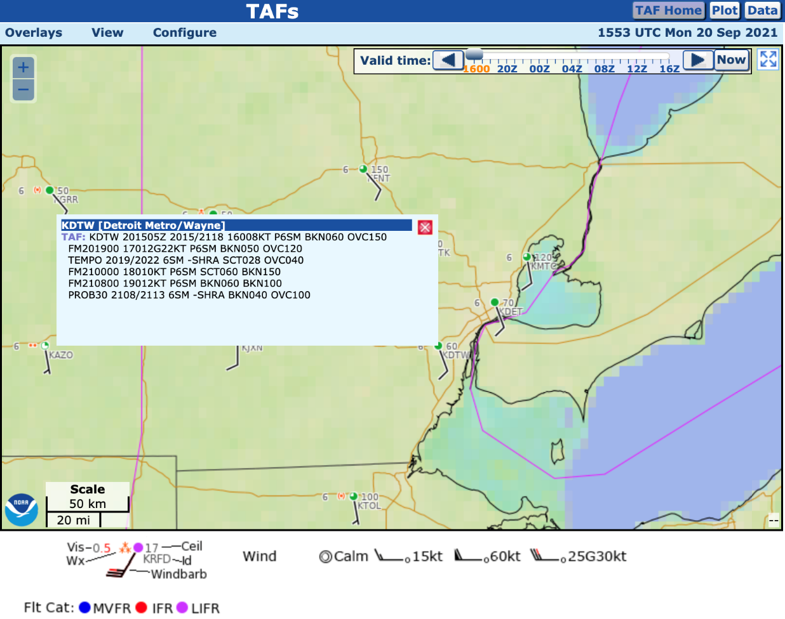
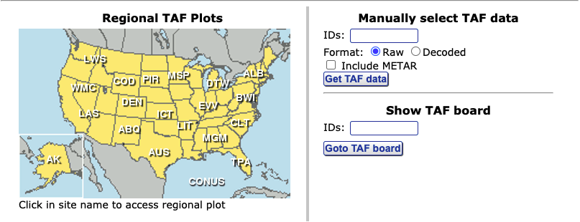
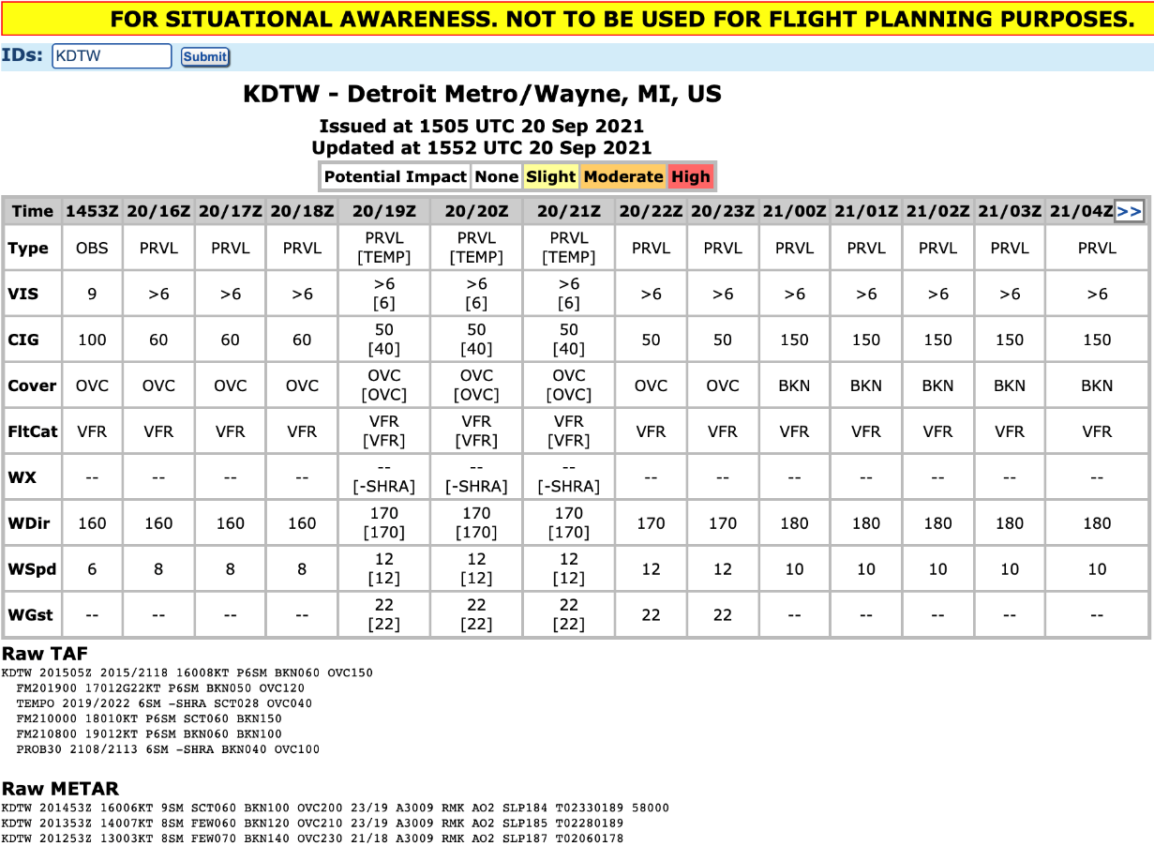
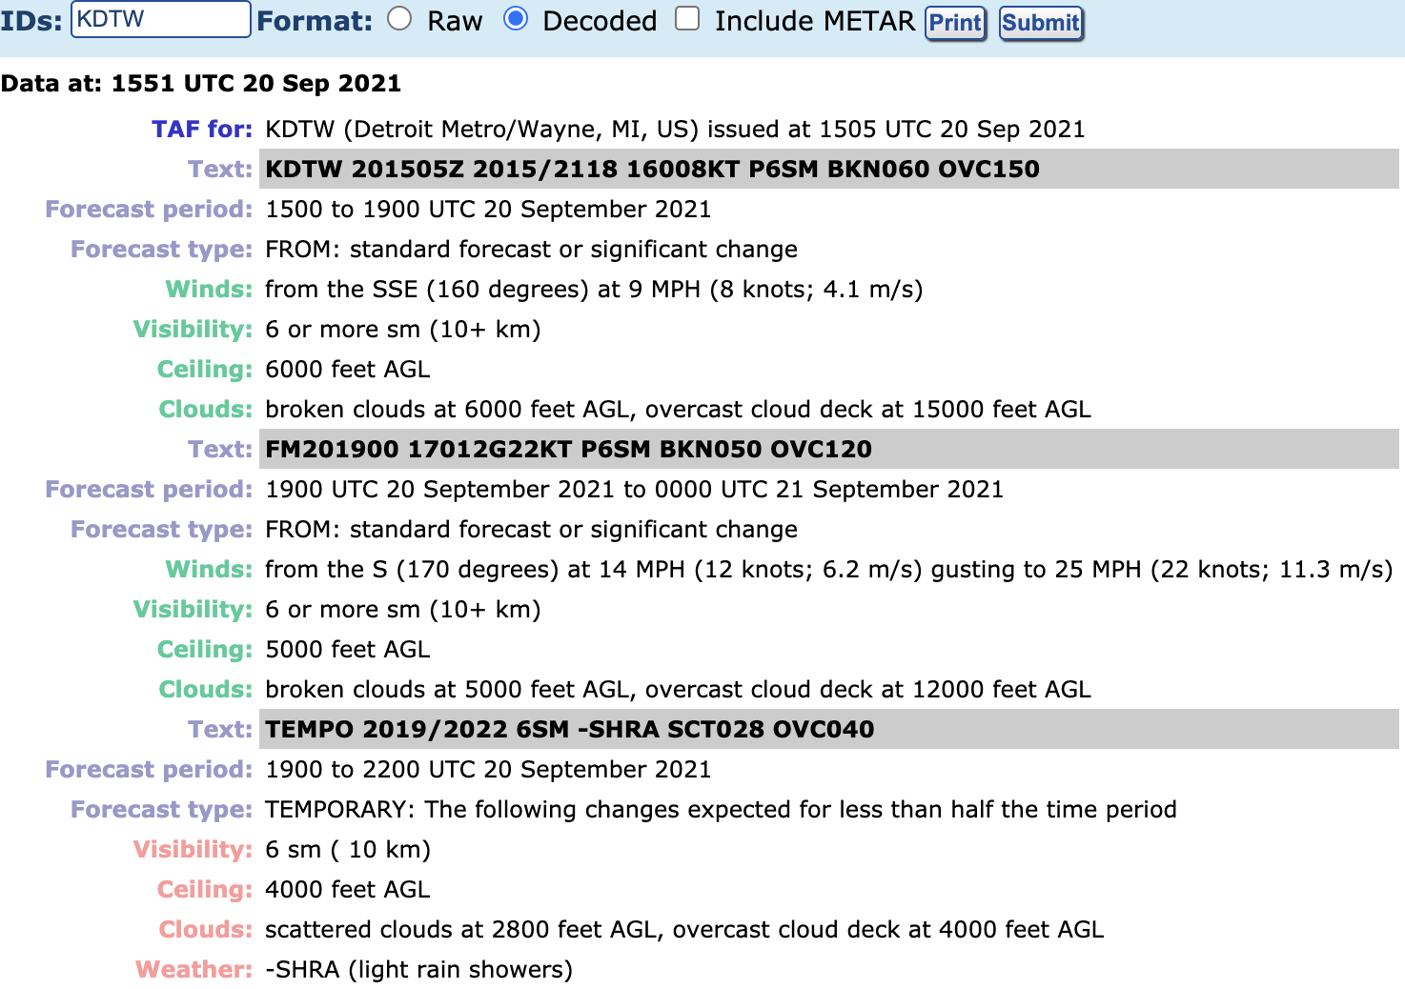
TAFs
Terminal Aerodrome Forecast (TAFs)
AWC does not write TAFs, they only display TAFs from the respective WFO
TAF board is a terminal specific forecast for the impact on operations (assuming the TAFs verify)
AWC provides automatic decoded TAFs through the 24 hour TAF period
Major airports (e.g. Detroit) have TAFs that go out through 30 hours

Slide 15
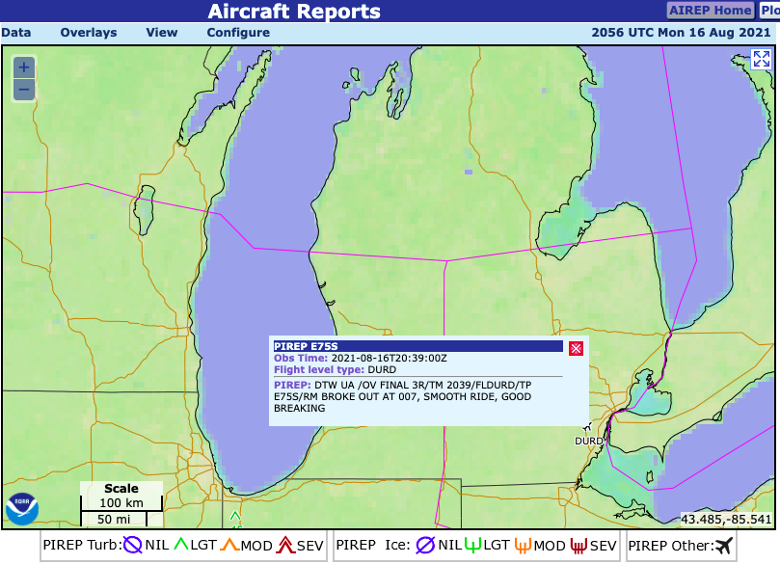
PIREPs
Pilot Reports (PIREPs)
Must include:
Report Type: Routine (UA) or Urgent (UUA), Location (OV), Time (TM), Flight Level (FL), Aircraft Type (TP)
Optional to include:
Sky Cover (SK), Ambient Temp (TA), Wind Vector (WV), Turbulence (TB), Icing (IC), Weather (WX), Remarks (RM)

Slide 16
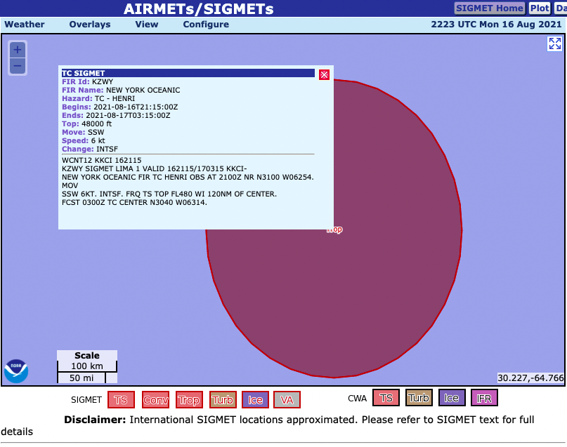
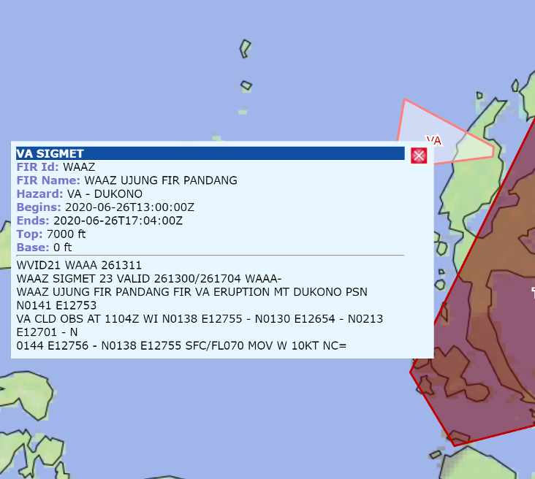
SIGMETs
SIGnificant METeorological Advisories (SIGMETs) are issued by the AWC (and international aviation authorities)
Advises for weather, other than convective activity, that is potentially hazardous to all aircraft
4 hour duration, issued for:
Severe Icing
Severe or Extreme Turbulence
Dust Storms or Sandstorms
Volcanic Ash (pictured)

Slide 17
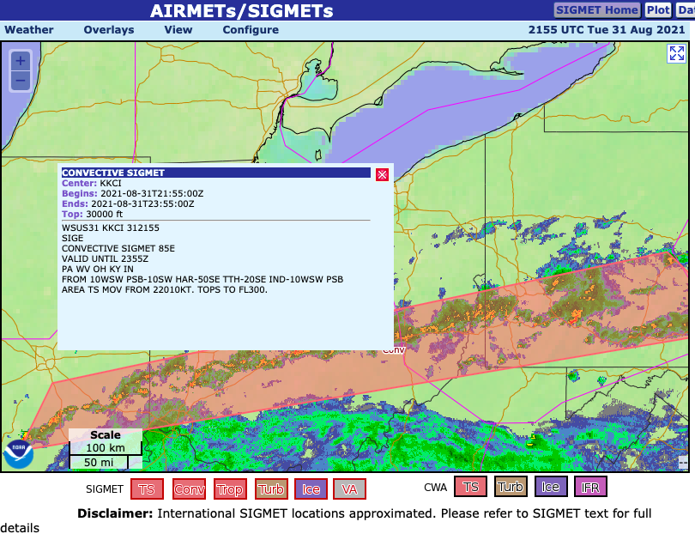
Convective SIGMETs
2 hour duration SIGMET, issued for
Lines of thunderstorms at least 60 miles long
Areas of strong thunderstorms
Embedded or severe thunderstorms expected to occur for more than 30 minutes
Special issuance criteria include:
Tornados
Hail greater/equal to ¾” diameter
Gusts of 50 knots or greater
Notes:
+40% spatial coverage requirements. Any convective SIGMET implies severe or greater turbulence, severe icing, and low-level wind shear. A convective SIGMET may be issued for any convective situation which the forecaster feels is hazardous to all categories of aircraft. Bulletins are issued hourly at Hour+55. The text of the bulletin consists of either an observation and a forecast or just a forecast. The forecast is valid for up to 2 hours.

Slide 18
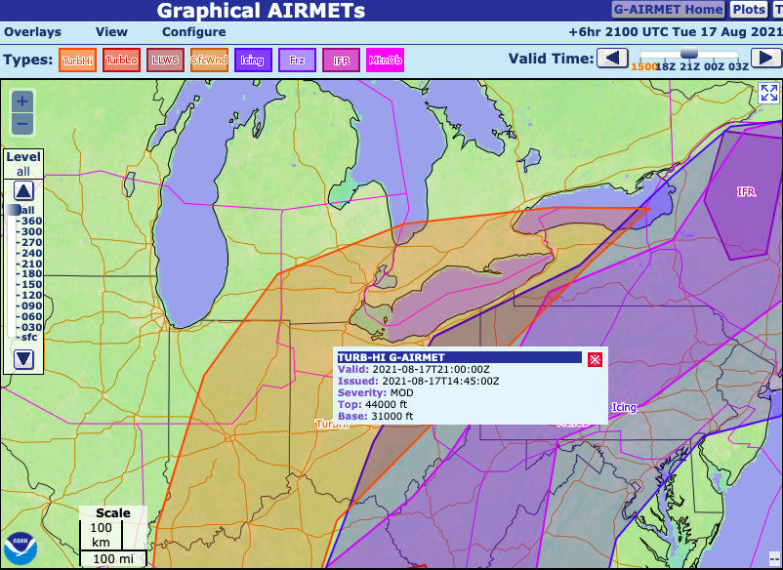
AIRMETs
AIRMET (AIRman's METeorological Information) advises of weather that may be hazardous for single engine, light aircraft, and Visual Flight Rule (VFR) pilots
AIRMET Sierra (IFR): Ceilings less than 1000 feet and/or visibility less than 3 miles
AIRMET Tango (Turbulence): Moderate turbulence or sustained surface winds of 30 knots
AIRMET Zulu (Icing): Moderate icing and/or low freezing levels

Slide 19
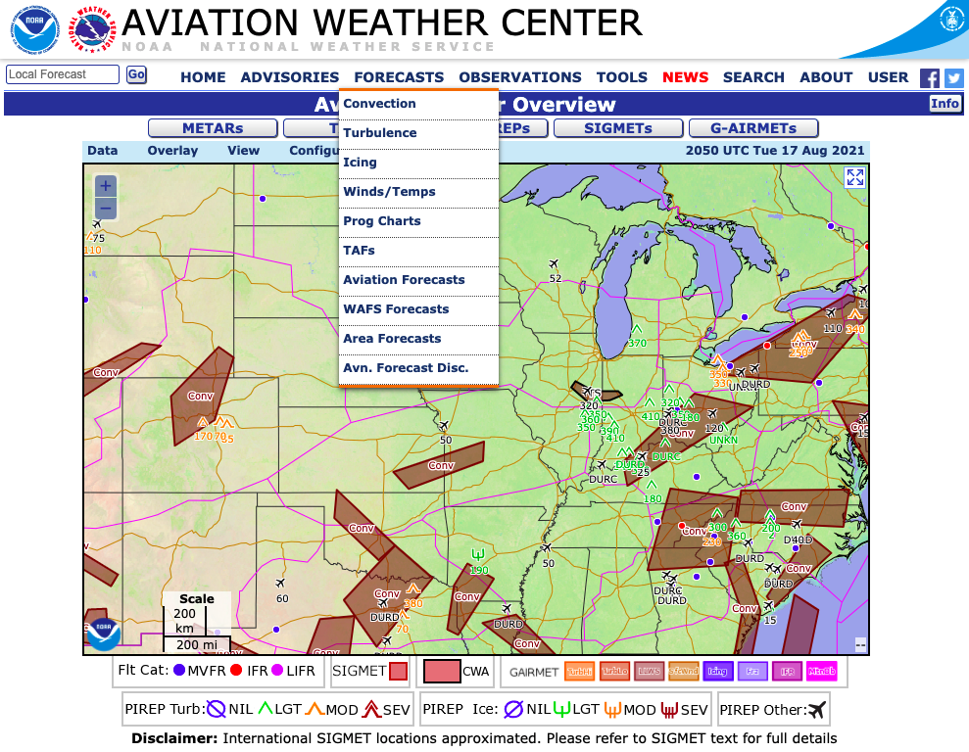
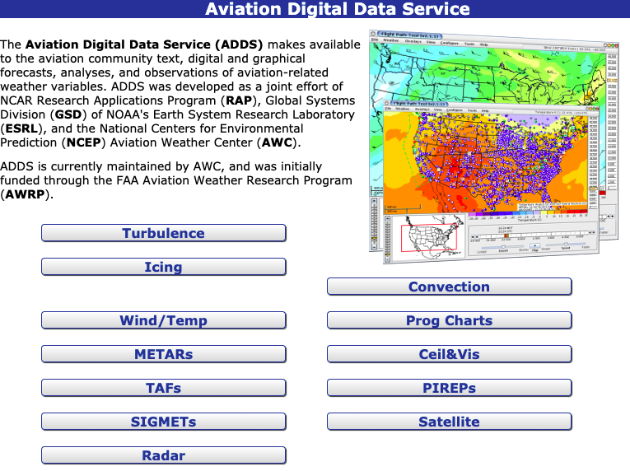
Aviation Weather Center Forecasting Tools
AWC Forecasts Menu
The AWC Forecast menu is one method to view many of the previously mentioned parameters comprising the AWC’s Aviation Digital Data Service (ADDS) which is funded via the FAA
Database of text, digital/graphical forecasts, analyses, and observations of aviation-related weather variables
Access products by mousing over the FORECASTS tab at the top of the homepage and selecting the corresponding parameter or via the dedicated ADDS webpage:
https://www.aviationweather.gov/adds/

Slide 20
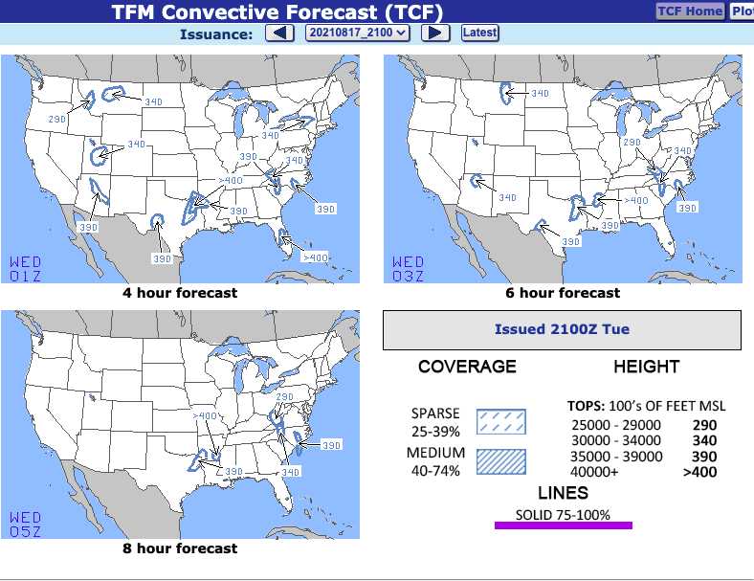
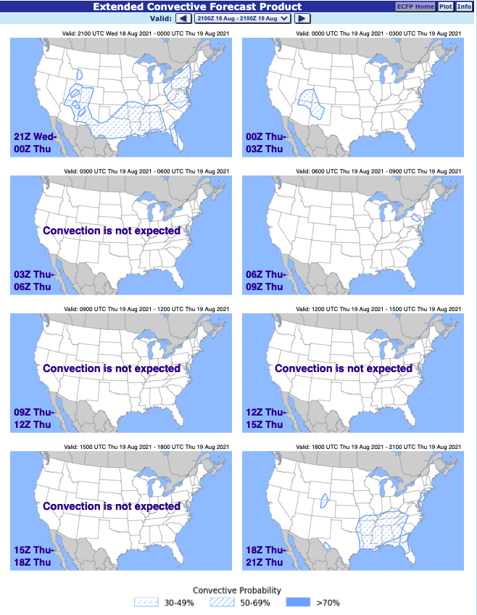
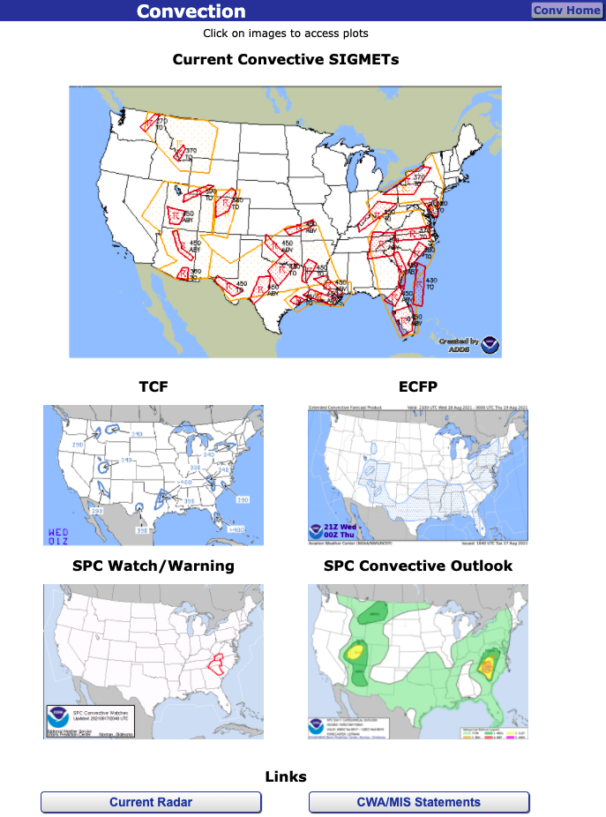
Aviation Weather Center Forecasting Tools
Convection
Shows current Convective SIGMETs, TCF, ECFP, non-aviation convective Watches/Warnings, and SPC outlooks
TFM Convective Forecasts (TCF) are 4, 6, and 8 hour convective forecasts for storm coverage (area vs line) and cloud tops
Extended Convective Forecast Product is similar to TCF, but 3 hourly through the next 72 hours (with lesser criteria)
SPC products are the same ones referenced in earlier slides, just another way to access them
Notes:
Training:
A Traffic Flow Management (TFM) Convective Forecast (TCF) training package may be found at https://tfmlearning.faa.gov/.
Product Description:
The TCF is a high confidence graphical representation of forecasted convection meeting specific criteria of coverage, intensity, and echo top height. The TCF graphics are produced every 2 hours and valid at 4-, 6-, and 8- hours after issuance time.
Areas of convection in the TCF include any area of convective cells containing (at a minimum):
Composite radar reflectivity of at least 40 dBZ;
Echo tops at or above FL250;
Coverage (a & b) of at least 25% of the polygon area;
Forecaster confidence of at least 50% (High) that criteria (a, b, & c) will be met.
Lines of convection in the TCF include any lines of convective cells:
Composite radar reflectivity of at least 40 dBZ having a length of at least 100 nautical miles (NM); and
Having a linear coverage of 75% or greater; and
Having echo tops at or above FL250.
Forecaster confidence of at least 50% (High) that criteria (a, b, & c) will be met.
All four of the threshold criteria listed above for both areas and lines of convection are required for inclusion in the TCF. This is defined as the minimum TCF criteria.
The TCF domain is the Flight Information Regions (FIR) covering the 48 contiguous states and adjacent coastal waters. It also includes the Canadian airspace south of a line from Thunder Bay, Ontario to Quebec City, Quebec.
~~~~~~~~~~~~~~~~~~~~~~~~~~~~~~~~~~~~~~~~~~~~~~~~~~~~~~~~~~~~~~~~~~~~~~~~~~~~~~~~~~~~~~~~~~~~~~~~~~~~~~~~~~
ECFP Background
The Extended Convective Forecast Product (ECFP) Planning Tool is a graphical representation of the forecast probability of thunderstorms. The product identifies graphically where in the US thunderstorms are likely over the next 72 hours. It is intended to enhance the TFM Collaborative Forecast (TCF). The TCF is only valid out to 8 hours. The product is not a TCF forecast (it is not forecasting the exact TCF criteria), but intended to support the long range planning for TCF type of constraints in the National Airspace System.
The ECFP planning tool has been developed in response to FAA and Industry needs in planning for weather hazards, specifically convection, one to two days in advance. To meet these planning needs, and to support TCF planning beyond 8 hours, the ECFP is intended to provide traffic planners and collaborators a quick-look forecast of the greatest probability of convection/thunderstorms.
The ECFP is intended for FAA Traffic Managers at Air Route Traffic Control Centers (ARTCC), FAA Air Traffic Control System Command Center (ATCSCC), airline and aviation industry dispatch and flight planners, and private weather vendors supporting airline/FAA.
New 3 Hour ECFP
This new ECFP depiction is an automated graphical forecast created from the Short Range Ensemble Forecast (SREF) Calibrated Thunderstorm guidance with forecast times valid in 3 hour intervals. Probability of Thunderstorm contours are depicted at 30, 50, and 70% probabilities. Blue hashed areas represent 30-49% probability, solid orange-lined areas represent 50-69% probability, and solid magenta-filled areas represent greater than 70% probability.

Slide 21
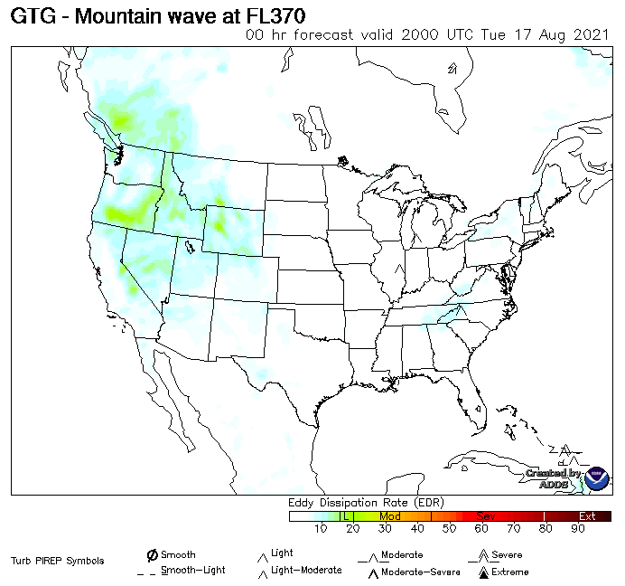
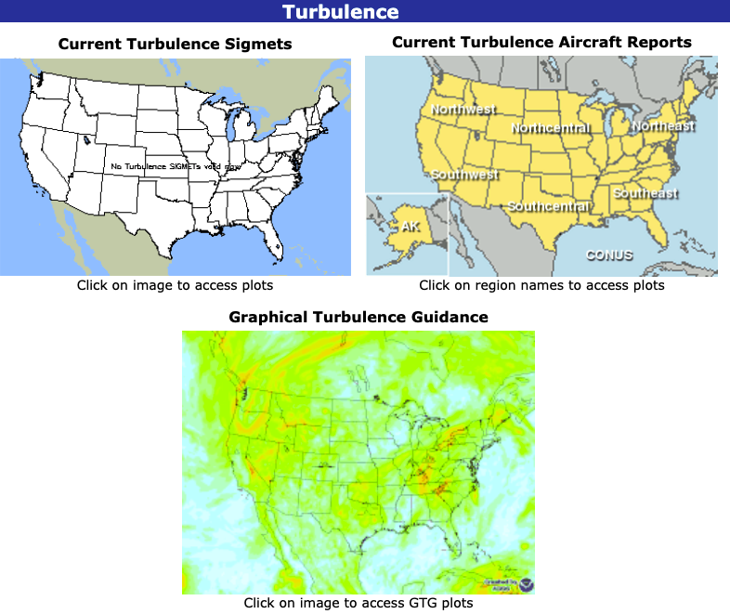
Aviation Weather Center Forecasting Tools
Turbulence
Shows current turbulence SIGMETs, turbulence PIREPs, and graphical turbulence guidance
Graphical turbulence guidance is specific to aircraft type (small, medium, or large)
Highlights light, moderate, severe, and extreme categories based on the Eddy Dissipation Rate at various flight levels for Clear Air Turbulence
Also features a Mountain Wave option

Slide 22
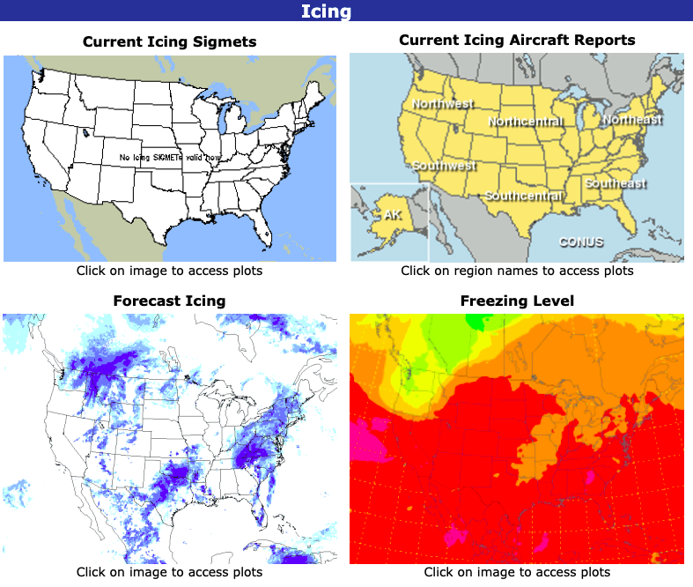
Aviation Weather Center Forecasting Tools
Icing
Shows current icing SIGMETs, icing PIREPs, maximum icing severity forecast, and freezing level
Expected icing severity is broken up into five categories: none, trace, light, moderate, and heavy
Based on the accretion rate of ice on an airplane, and the levels are determined by the time it would take for an airfoil to accrete 1/4 in of ice: 1 hr: trace, 15 min-1 hr: light, 5-15 min: moderate, <5 min: heavy/severe

Slide 23
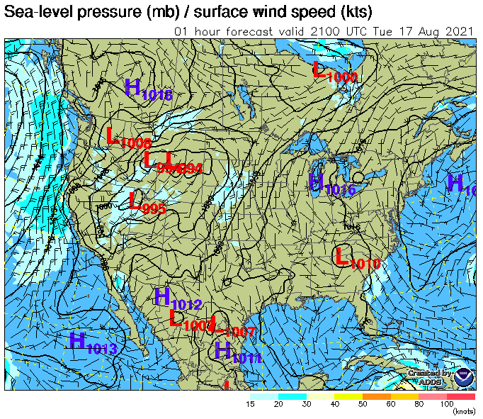
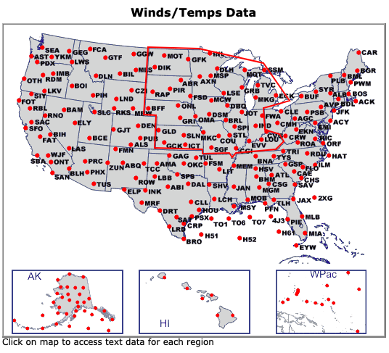
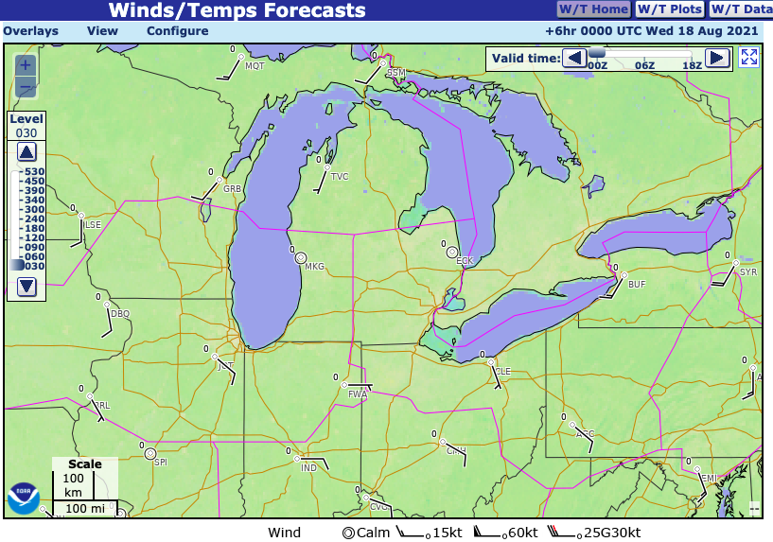
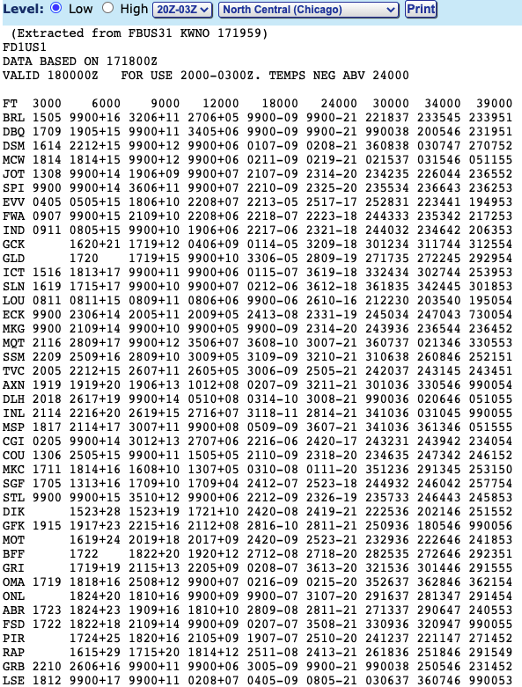
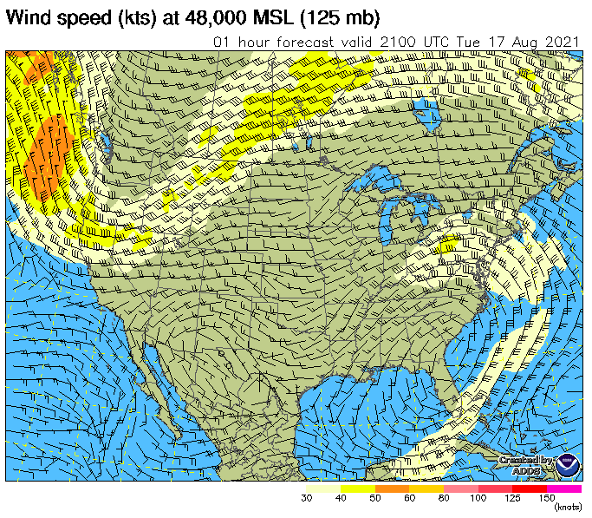
Aviation Weather Center Forecasting Tools
Winds/Temperature
Instead of the METAR view where all present weather parameters are included, wind/temps exclusively displayed representing forecast data (not current obs)
Other plots for wind speed, temperature, temperature difference, and streamlines from MSLP to FL480
Section out wind and temperature data in tabular format for 6, 12, and 24 hours for various levels
ddffttt where dd is the wind direction in 10s of degrees, ff is the win speed in knots and ttt is the temperature in Celsius.
Notes:
At higher levels, the sign for the temperature is not needed since it's assumed all values are negative. If the first digit of the wind direction is greater than 4, then the wind speed is greater than 100. For example, 810550 would be 310 degrees (80-50) at 105 knots and the temperature is -50C.

Slide 24
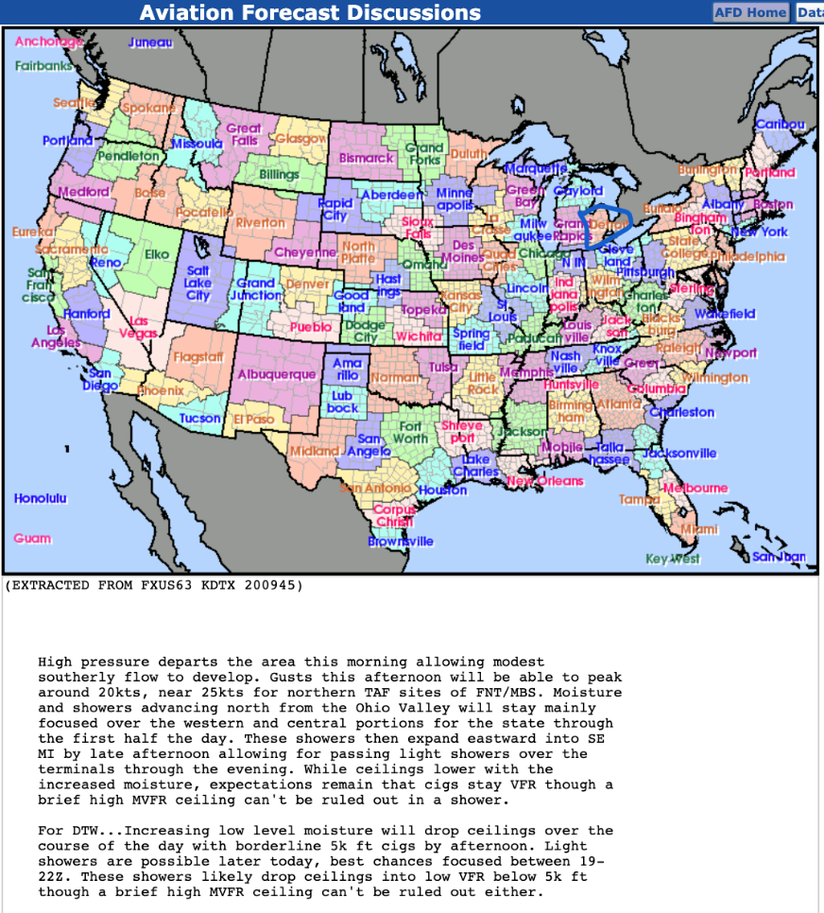
Aviation Weather Center Forecasting Tools
Aviation Forecast Discussions
Every WFO is required to write an Aviation Area Forecast Discussion (Aviation AFD) describing the forecast meteorological conditions and impact on aviation operations
Typically will mention nuances between TAF sites and certainty with respect to forecast conditions
AWC page is a one-stop-shop for each WFOs’ Aviation discussions

Slide 25
Aviation Forecasting
General Forecasting Tools
Surface Observations
Upper Air Observations
Radar/Satellite Trends
Numerical Weather Prediction
Model Output Statistics (MOS)
Probabilistic Data
TAF Monitoring

Slide 26
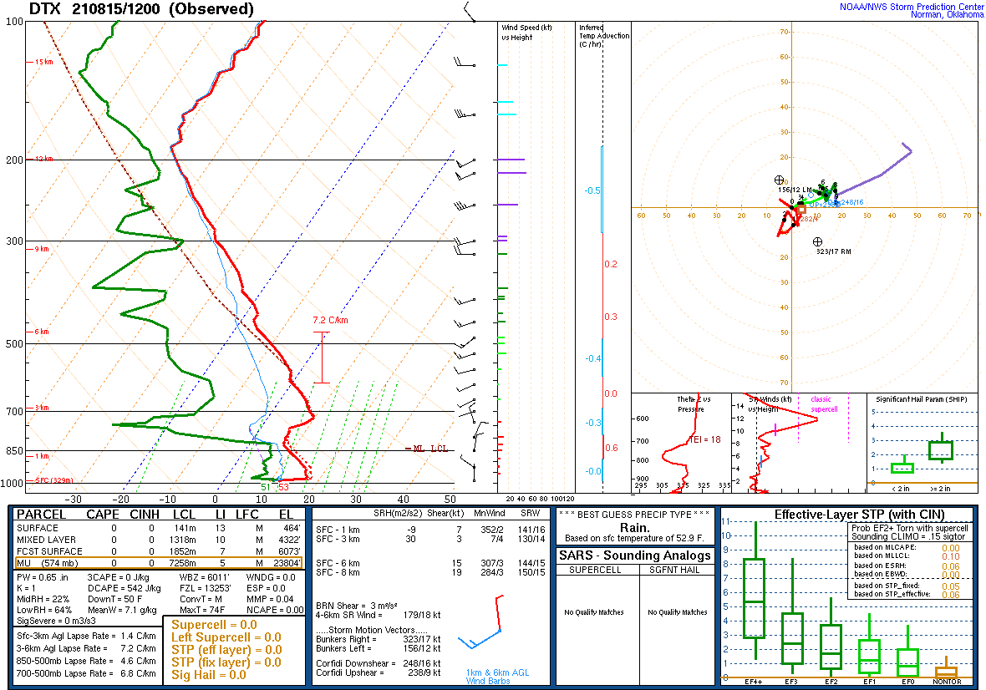
Aviation Forecasting
Upper Air Observations
Closest upper air locations are Detroit (KDTX) and Gaylord (KAPX)
Weather balloons launched twice daily (12Z and 00Z), but additional releases can be authorized as needed (usually at 06Z or 18Z), especially when severe weather is imminent
Balloons launched with an instrument (radiosonde) that measures temperature, pressure, humidity, and wind speed/direction
Gives a sample of the conditions above the surface, inputs for weather models

Slide 27
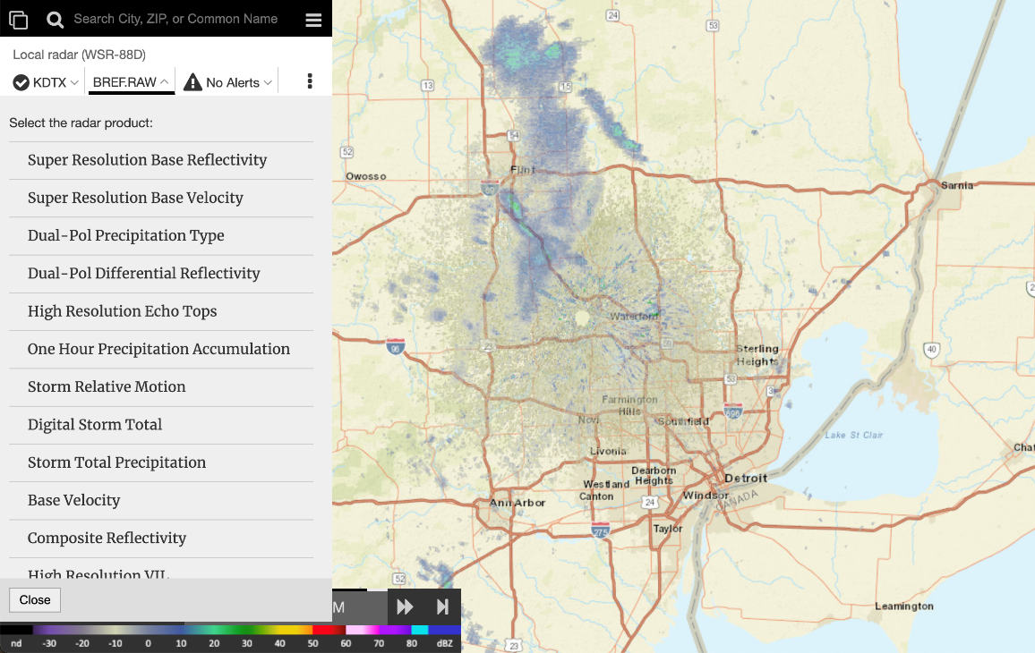
Aviation Forecasting
Radar
WSR-88D Radars
Terminal Doppler Radars (TDWR)
Detroit, Cleveland, O’Hare
Mosaic or site-specific (WSR-88D KDTX)
Need to change menu to Radar Station Products from Upper left icon
Reflectivity (see right)
Precipitation
Velocity (above surface wind/direction)
https://radar.weather.gov

Slide 28
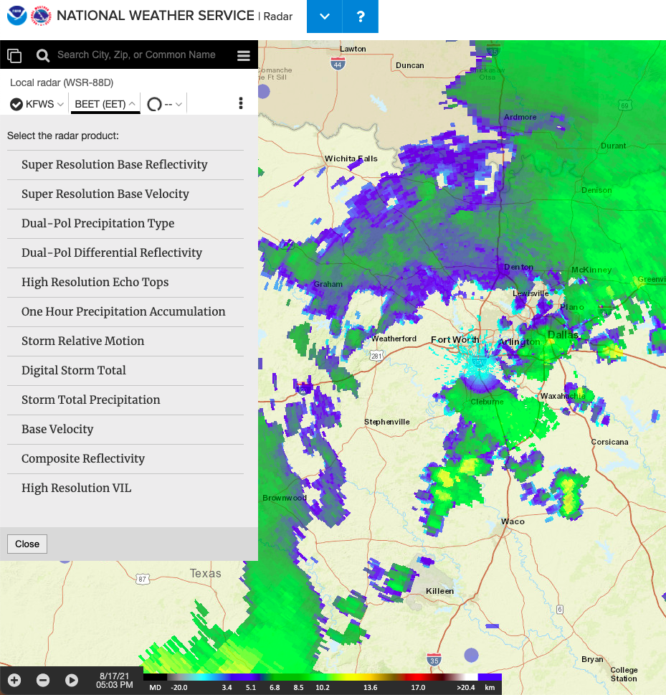
Echo Tops
Radar
Not many forecast graphics or guidance available for predicting cloud top heights
NWS radars can detect the edges of clouds (called Echo Tops), but this is a current state, not a forecast
Available as a layer via the same NWS radar page

Slide 29
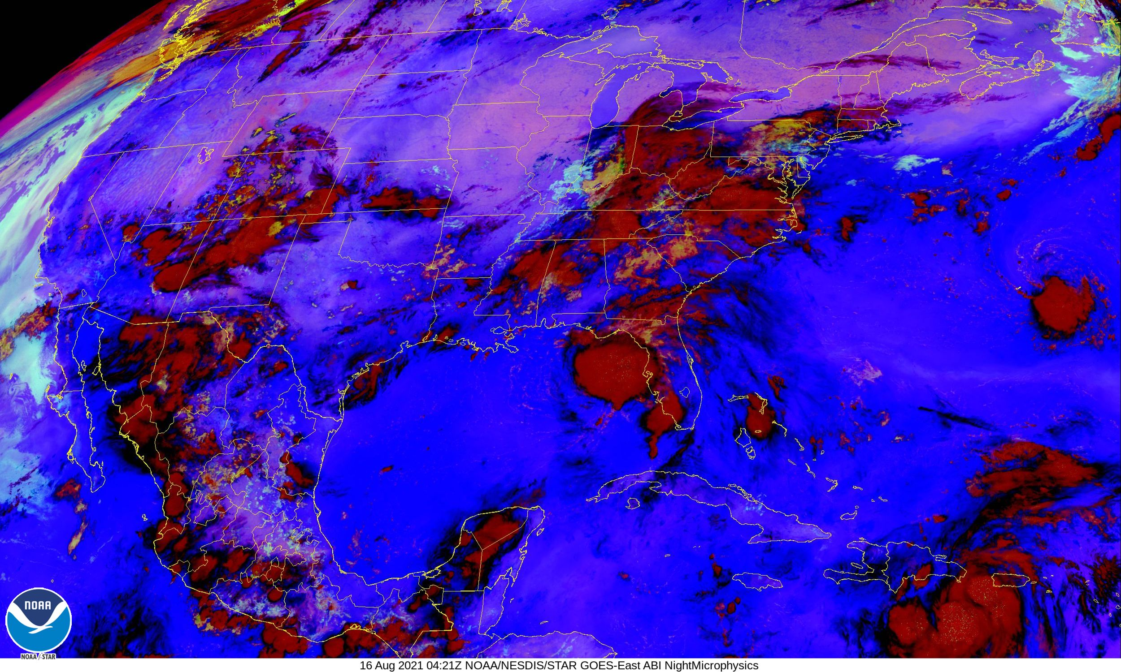
Aviation Forecasting
Satellite
Geostationary Earth Orbiting Satellite (GOES)
Two identical satellites
One for eastern and one for western North American
Fixed location sampling cloud temperature, water vapor, ice, CO2, ozone, and visible clouds
Composite imagery (blend of multiple channels) can help discern mixed cloud levels and fog (or low stratus)
GOES now include lightning detection

Slide 30
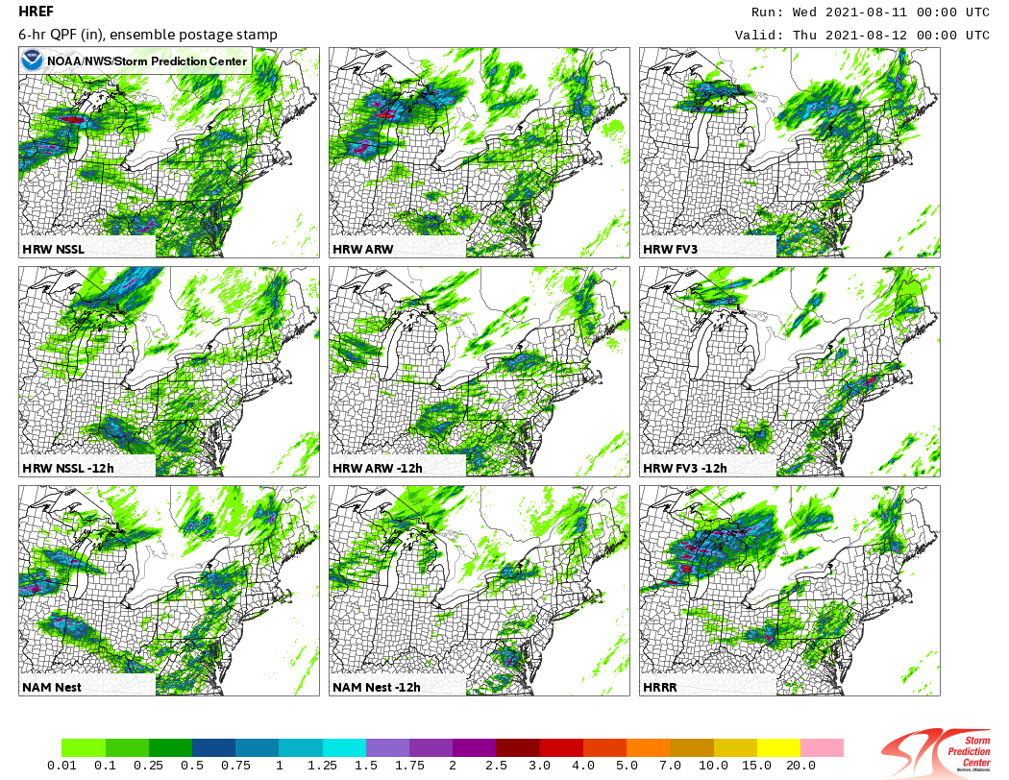
Aviation Forecasting
Numerical Weather Prediction
Models process a massive amount of observation data (surface and upper air) then run complex equations to produce a numerical solution
Covers different timescales, geographic areas, and spatial resolutions
Some better resolve large scale changes (e.g. flight level winds) while others are more advantageous for smaller scale processes (e.g. thunderstorm initiation)

Slide 31
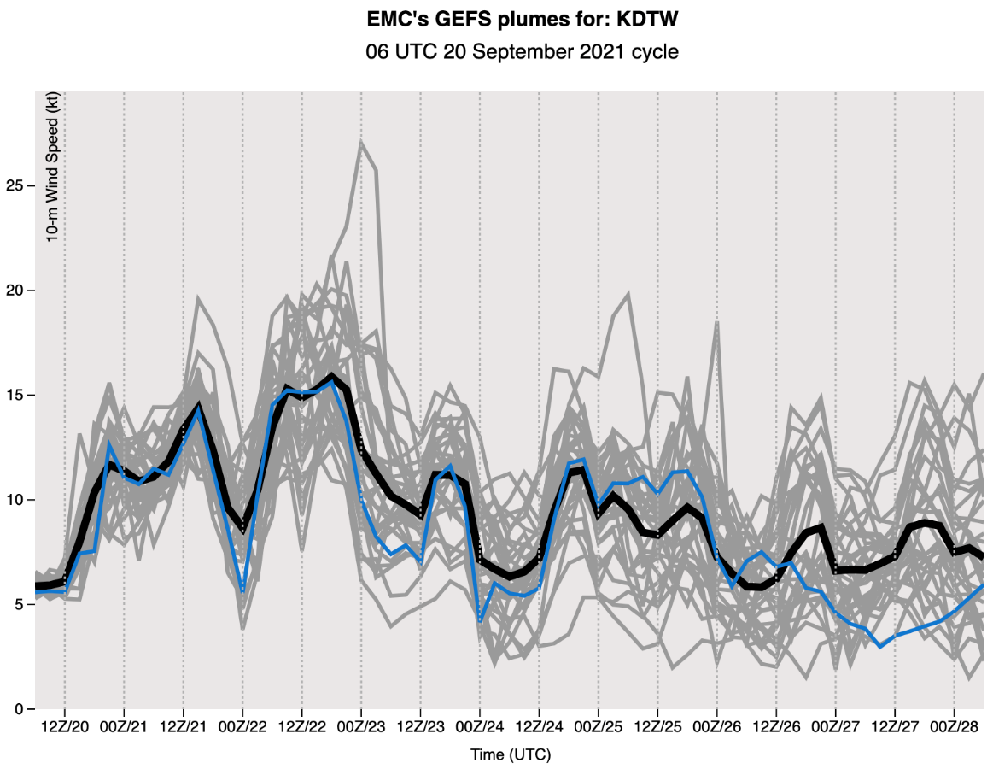
Aviation Forecasting
Numerical Weather Prediction
Medium to Long Range Models
NAM
GFS/GEFS
ECMWF/EPS
Canadian (CMC, RGEM)/GEPS
High-Resolution Short-Range Models
RAP/HRRR
ARW
FV3

Slide 32
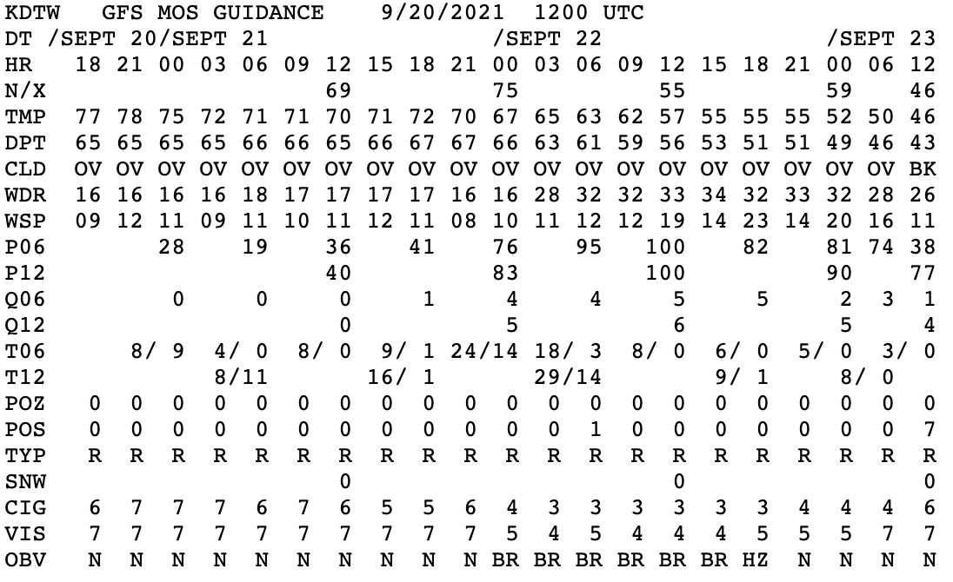
Aviation Forecasting
Model Output Statistics
Model Output Statistics (MOS) is a type of statistical post-processing
Objectively interprets model output based on historical sample to better predict large-scale events
Corrects for certain model biases and accounts for some local effects
Predictors
NWP Model Forecasts
Prior Observations
Geoclimatic Data

Slide 33
Aviation Forecasting
Probabilistic Data
GFS-LAMP (Localized Aviation MOS Program) guidance is currently available every hour
Provides guidance for over 2000 stations
Generates probabilistic and conditional forecasts for aviation weather elements (e.g. ceiling height and visibility)
Best-category forecasts are derived from these probabilities and associated thresholds

Slide 34
Aviation Forecasting
TAF Monitoring
AVNFPS is the primary monitoring application WFO aviation meteorologists use to compare current METARs to TAFs in effect
Alerts forecasters when the current flight category (based on latest METAR) doesn’t align with the current TAF
Also applies for wind speed, direction, LLWS, current weather, and lightning presence

Slide 35
Questions?
kevin.kacan@noaa.gov

